Slide 1
Jose Pablo Morales, MD FDA Division of Cardiovascular Devices Center for Devices and Radiological Health (CDRH) CRT February 20, 2017
Regulatory Perspectives on
Real World Evidence (RWE)

Slide 2
Disclosure Statement
I, Jose Pablo Morales, do not have a financial interest/arrangement or affiliation with one or more organizations that could be perceived as a real or apparent conflict of interest in the context of the subject of this presentation

Slide 3
Randomized Controlled Trials (RCT)
One of the most powerful tools clinical researchers possess
Enables them to evaluate the effectiveness of new (or established) therapies while accounting for the effects of unmeasured confounders and selection bias by indication
However, RCT reputation has suffered of late, owing to reasonable concern about excess complexity, expense, and time required to recruit study participants, as well as inadequate representativeness
E.g., results are not applicable to real-world patients

Slide 4
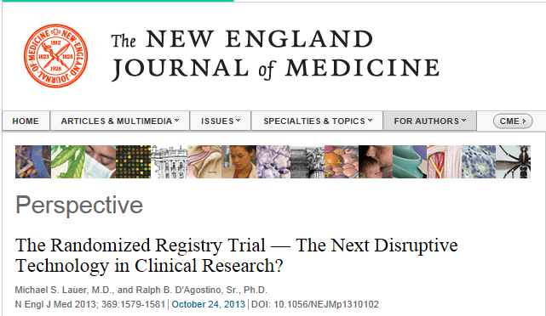
Drs. Lauer and
D’Agostino argue
that the use of
observational registries
in conducting clinical trials
could, in fact, be a game
changer, especially in the current fiscal climate
Notes:
2013 NEJM

Slide 5
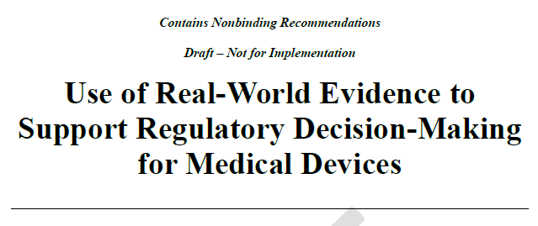
Real-World Evidence (RWE) is the evidence derived from aggregation and analysis of Real-World Data (RWD) elements.
RWD is data collected from sources outside of traditional clinical trials. These sources may include large simple trials, or pragmatic clinical trials, prospective observational or registry studies, retrospective database studies, case reports, administrative and healthcare claims, electronic health records, data obtained as part of a public health investigation or routine public health surveillance, and registries (e.g., device, procedural, or disease registries).
The data is typically derived from electronic systems used in health care delivery, data contained within medical devices, and/or in tracking patient experience during care, including in home-use settings.
Notes:
2016 Draft Guidance

Slide 6
Registries: Basic Principles for Success
Developing uniform definitions and CRFs for a particular area
Defining relevant questions
Establishing quality by design principles to ensure data quality and ability of registry to withstand audit
Successfully addressing any relevant informed consent issues
Developing incentives for sustainability of the registry

Slide 7
Registry Data: Pre-Market Regulatory Perspective
Division of Cardiovascular Devices (DCD) has actively worked with manufacturers and professional societies on cardiovascular projects
Registries are useful data collection tools
Proactive Collaboration
Early engagement with industry, government agencies and professional societies

Slide 8
Registry Uses for Cardiovascular Devices
Meeting post-approval study (PAS) requirements for new devices
Several examples and many PAS ongoing
Leveraging the registry(ies) infrastructure to nest IDE studies
Working towards
More broadly contribute to a learning health model

Slide 9
Example of meeting post-approval requirements: Type B Dissection Post-Approval Surveillance Program
Vascular Quality Initiative (VQI) from the Society for Vascular Surgery (SVS)
The Dissection VQI data set consists of four cohorts:
1) Acute Dissection with five year follow-up,
2) Chronic Dissection with five year follow-up,
3) Acute Dissection with one year follow-up, and
4) Chronic Dissection with one year follow-up.
The 5 Year Acute and Chronic cohorts will enroll 200 patients each, and of the 200 patients in each cohort, at least 60 must be treated with a given device manufacturer.
There will not be a minimum enrollment requirement for the 1 Year Acute and Chronic cohorts; however, there will be a maximum of 200 patients enrolled in those cohorts.

Slide 10
Leveraging the registry(ies) infrastructure to nest IDE studies
Registry Assessment of Peripheral Interventional Devices (RAPID)
Launched June 5, 2015
Goal
Standardize core data elements that could serve as a global case report form for both pre- and post-market assessment of peripheral arterial interventional devices

Slide 11
RAPID Partners
3 Major U.S. Societies / Registries
American College of Cardiology (ACC)
National Cardiovascular Disease Registry (NCDR)
Society of Interventional Radiology (SIR)
National Interventional Radiology Quality Registry (NIRQR)
Society for Vascular Surgery (SVS)
Vascular Quality Initiative (VQI)
5 International Partners
Japan’s Pharmaceuticals and Medical Devices Agency (PMDA)
Global Medical Device Nomenclature Agency (GMDNA)
Australian Vascular Audit
German Vascular Society
Northern German Association for Vascular Medicine

Slide 12
RAPID Partners
7 U.S. Agencies
FDA (CDRH pre- and post-market, and CDER)
Agency for Healthcare Research and Quality (AHRQ)
Centers for Medicare and Medicaid Services (CMS)
Department of Defense (DOD) Healthcare Resources
Office of the National Coordinator (ONC)
National Heart, Lung and Blood Institute (NHLBI)
National Library of Medicine (NLM)
6 EHR / Registry / Clinical Research Companies
Healthjump
Boston Biomedical Assoc.
Novella Clinical, Quintiles
Epic
M2S
MedStreaming

Slide 13
RAPID Partners
12 Device Manufacturers
Abbott
Aortic Medical Inc.
Avinger
Boston Scientific
Cardiovascular Systems Inc
Cook Medical
CR Bard
Medtronic
Spectranetics Corp
Terumo
Volcano Corp/Phillips Health Technology
WL Gore

Slide 14
RAPID Leadership
Co-Chairs:
Pablo Morales
Food and Drug Administration (FDA)
Robert Thatcher
4C Medical Technologies
Jack Cronenwett
Society for Vascular Surgery (SVS) Vascular Quality Initiative (VQI)
Project Manager:
Rebecca Wilgus
Clinical Informatics, Duke Clinical Research Institute (DCRI)
MDEpiNet Key Advisors:
Mitchell Krucoff, DCRI
Danica Marinac-Dabic, FDA

Slide 15
RAPID Project Plan
Phase 1: Identify minimal set of core data elements for registry assessment of lower extremity arterial devices
Obtain data elements from existing registries and industry case report forms used for pivotal device approvals.
Develop structured comparison report of all relevant data elements to allow selection based on clinical expertise.
Select core data elements, develop technical specifications for each element and a method to integrate Unique Device Identifier (UDI) data for precise device specification.
Duke Clinical Research Center (DCRI)
Informatics Team: Anne Heath, Mary Williams

Slide 16
RAPID Project Plan
Phase 2: Develop data extraction interoperability across peripheral registries and hospital EHRs that provide patient-level data for core data elements
The ACC and SVS peripheral intervention registries would incorporate the core data elements.
EHR manufacturers would be encouraged to develop smart data elements for the core data set.
Core data set would be provided to other national registries, such as the International Consortium of Vascular Registries (ICVR).

Slide 17
RAPID Project Plan
Phase 3: Use a coordinated registries network (CRN) for studies supporting a regulatory decision.
Projects would extract minimal core data from different registries or other data sources, such as centers using the same EHR system
Individual projects might need supplementary data
Prospective clinical trial, pre-market study
Post-market study, surveillance
Objective performance criteria creation
Goal: Total Product Life Cycle evaluation of devices in real world practice.

Slide 18
RAPID
It is one project in a series initiated to advance and demonstrate the interoperable flow of data and information across electronic health information systems as a precursor to the National Evaluation System for Health Technology (NEST) articulated by Drs. Shuren and Califf.
JAMA. 2016;316(11):1153-1154

Slide 19
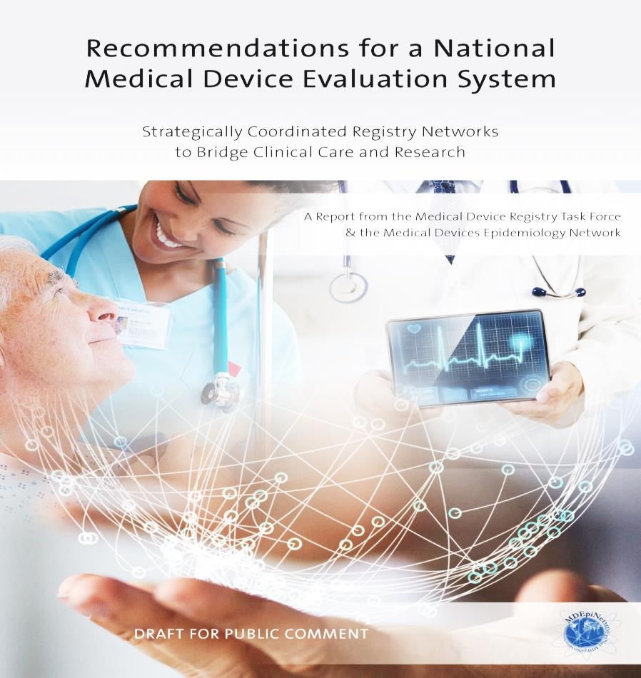
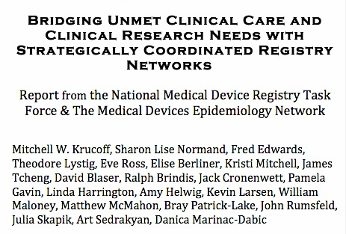
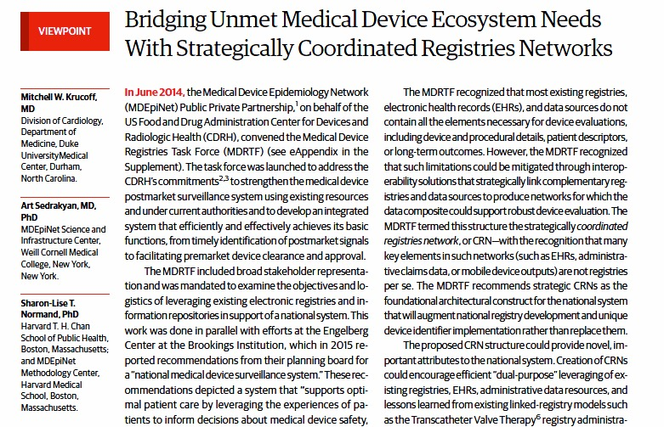
RAPID as Coordinated Registry Network (CRN)
CRN Principles:
Link complementary sustainable registries/e-repositories (Professional society registries, EHRs, VAMC, Claims data)
TPLC as a true continuum of structured “real world” evidence
“Dual purpose” existing site-base work flow
www.mdepinet.org
Krucoff MW, Normand SL et al, JAMA 2015

Slide 20
Real-World Evidence (RWE) is the evidence derived from aggregation and analysis of Real-World Data (RWD) elements.
RWD is data collected from sources outside of traditional clinical trials. These sources may include large simple trials, or pragmatic clinical trials, prospective observational or registry studies, retrospective database studies, case reports, administrative and healthcare claims, electronic health records, data obtained as part of a public health investigation or routine public health surveillance, and registries (e.g., device, procedural, or disease registries).
The data is typically derived from electronic systems used in health care delivery, data contained within medical devices, and/or in tracking patient experience during care, including in home-use settings.
Notes:
2016 Draft Guidance

Slide 21
Take home message
We are building up the foundation to assess medical devices being used for peripheral artery interventions
National and International
Multi-stakeholder collaboration is essential to move in the right direction
CRN are here to stay and if we develop them together they can work on our behalf
“This is an important step toward establishing the National Evaluation System for Health Technology” CDRH Director Jeff Shuren, MD, JD
https://www.dcri.org/mdepinet-rapid-project-seeks-improve-quality-efficiency-peripheral-interventional-device-evaluation/

Slide 22
Thank You

